Slide 1

Advanced Control Implementations with Modelica
FMH606 Master’s Thesis 2023 Industrial IT and Automation
Carl Magnus Bøe

Slide 2
Hva skal fortelles
Hva er situasjon nå
Hva ønsker man å endre
Hva finnes I markedet
Implementert modell
AIR HEATER
Different methods of calling external C I Modelica
Results and comparison
Calling NLopt
Results and comparison
FMU PID
Results and comparison
FMU MPC
Results and comparison

Slide 3
Introduction
Modelica
FMU
SIMULINK
Model Predictive Control Toolbox
Modelica
External Object
Notes:
Change to increase efficiency, reduce cost, reduce probability to include human error in the process.
Describe what FMU IS

Slide 4
Introduction
Modelica
External Object
Modelica
External Object
FMU
Python
Notes:
Change of title was approved on 2023.08.07 – level of knowledge in C-programming required to perform the implementation

Slide 5
Existing Options
Linear MPC Modelica Library
JModelica
Open-source
Last updated 2016
Not compatible with Modelica 4.0
Discontinued in 2019
Assimulo
PyFMI
FMI Library
FMPy - Dassault Systèmes
NLopt
Free Python FMU library
Graphical user interface
Validate FMUs
Export to Jupyter Notebook, Modelica and Cmake
Web App
Open-source optimization library
C, C++, MATLAB, Fortran, Python among others
Collection of several algorithms from different contributors
Notes:
Linear MPC Modelica Library
State space model
The demo models work when converted to Modelica 4.0 but not able to add air heater model
Jmodelica
Assimulo
Python simulation packages
PyFMI
C package to load and simulate FMUs
FMI Library
C package to load and simulate FMUs
FMPy - Dassault Systèmes
NLopt

Slide 6
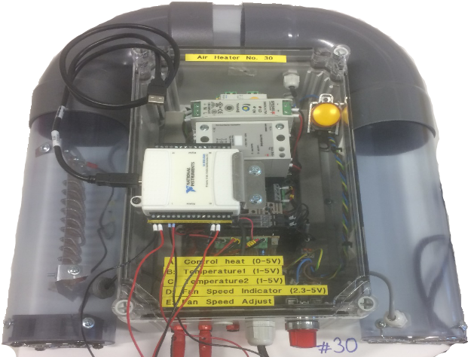
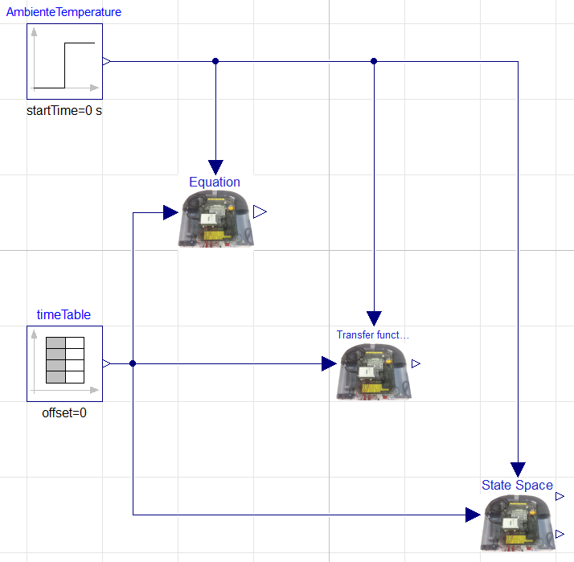
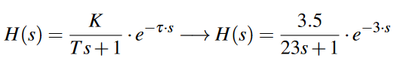
Air Heater Model
First-principle, transfer function, and state space models
$$T_{CONST}∙ der\left(T_{Out}\right)= \left(T_{amb}- T_{Out}\right)+ Kh∙ delay(u, 3)$$
Notes:
Air heater model - Time constant with time delay process dynamics
FIRST-PRINCIPLE
Implemented as a model in Modelica based on first-principle / mechanicstic model
Equation based
TRANSFERFUNCTION
Basic Modelica blocks
Time delay
Transfer function
STATE SPACE
Implemented with the use of SciPy Python package
Build transferfunction, then use series function to merge transfer and timedelay (padé)
All models simulated in same model, with same changes in setpoint

Slide 7
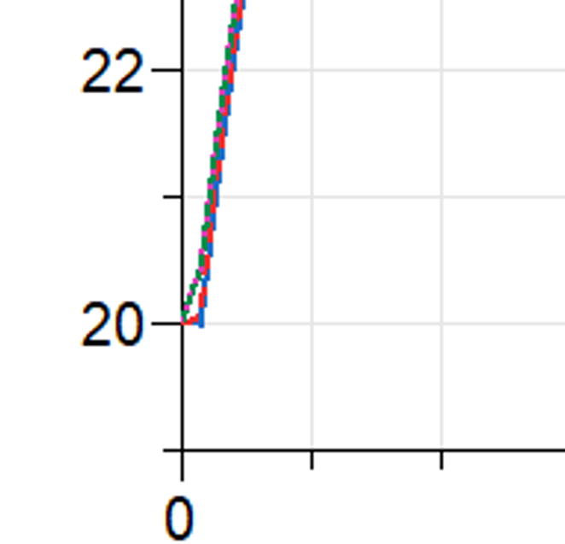
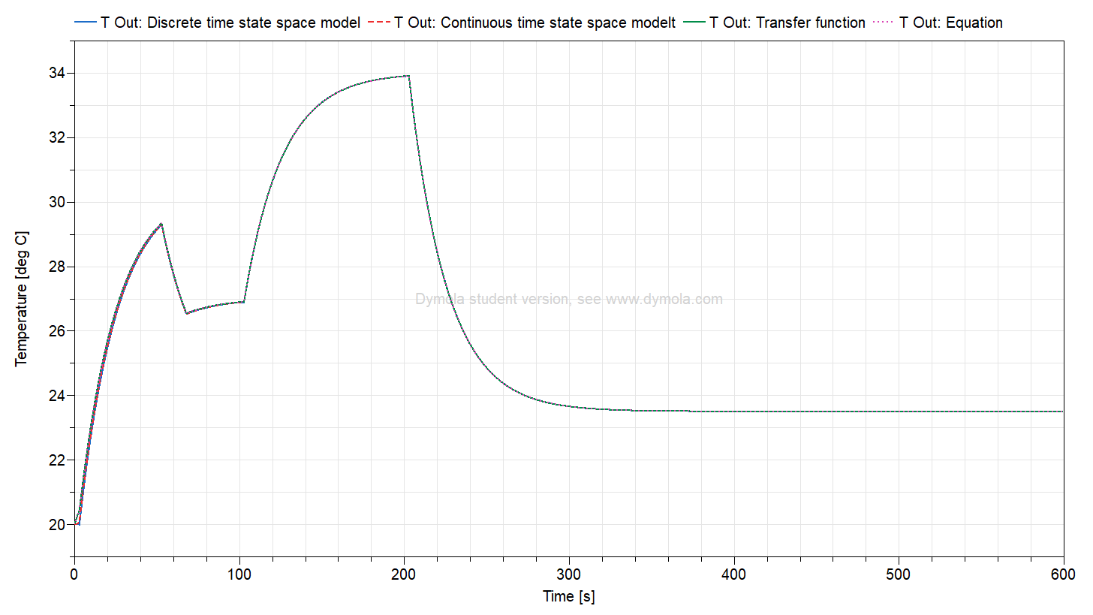
Air Heater Model
Model evaluation

Slide 8
Methods of Calling External C Code in Modelica
Modelica Function
Modelica External Object
Basic functions with one return variable
Needs a Modelica block or model as a wrapper
Extended functionality and complexity
Enables reading and writing of variables from external memory across C and Modelica

Slide 9
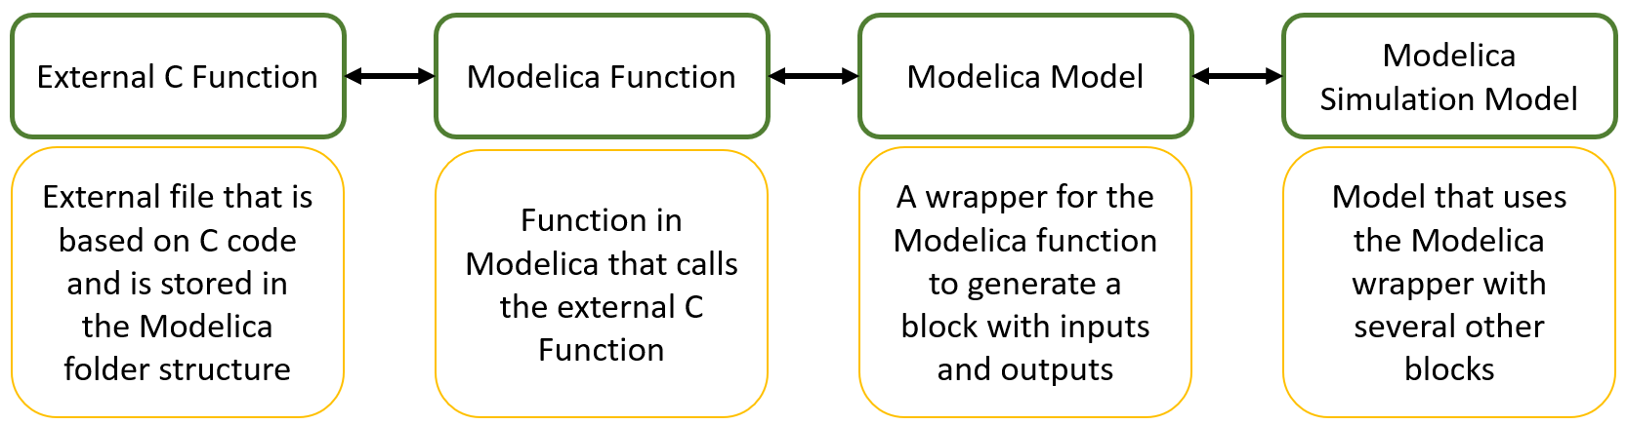
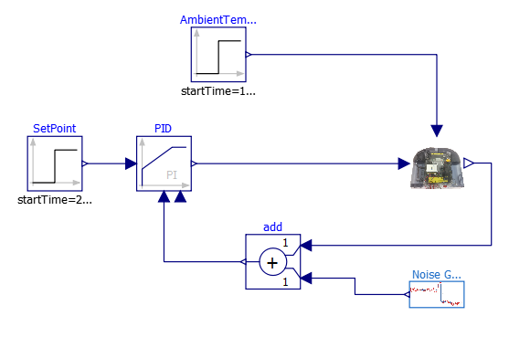
Modelica Function
Notes:
1.First
Has to return only one variable
Can be any C function

Slide 10
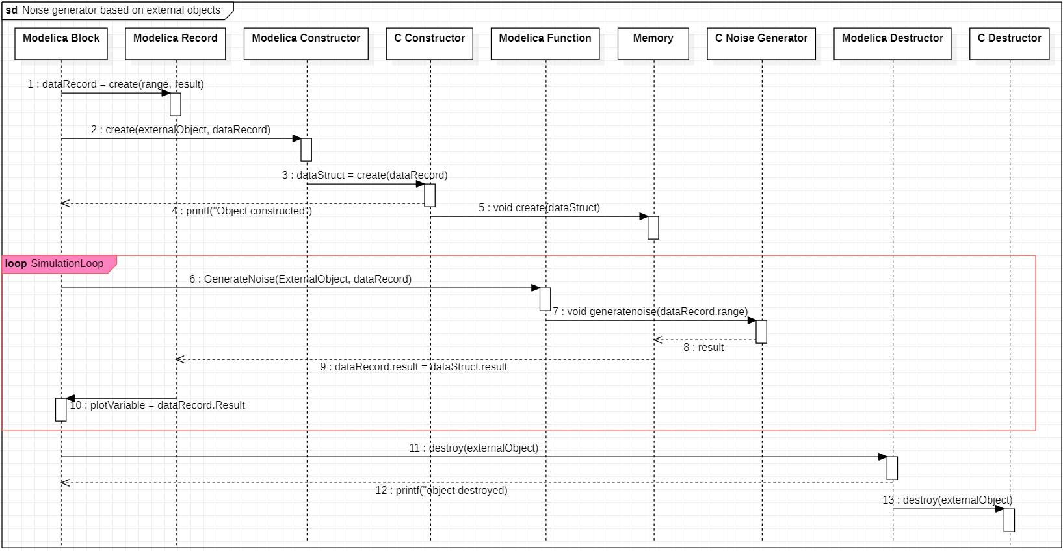
Modelica External Object
Notes:
Error: C Destructor writes object destroyed to the screen

Slide 11
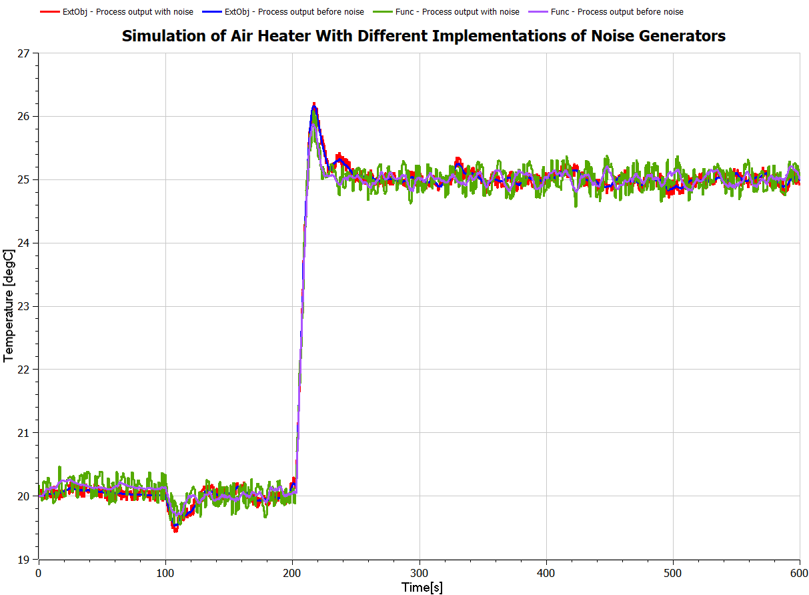
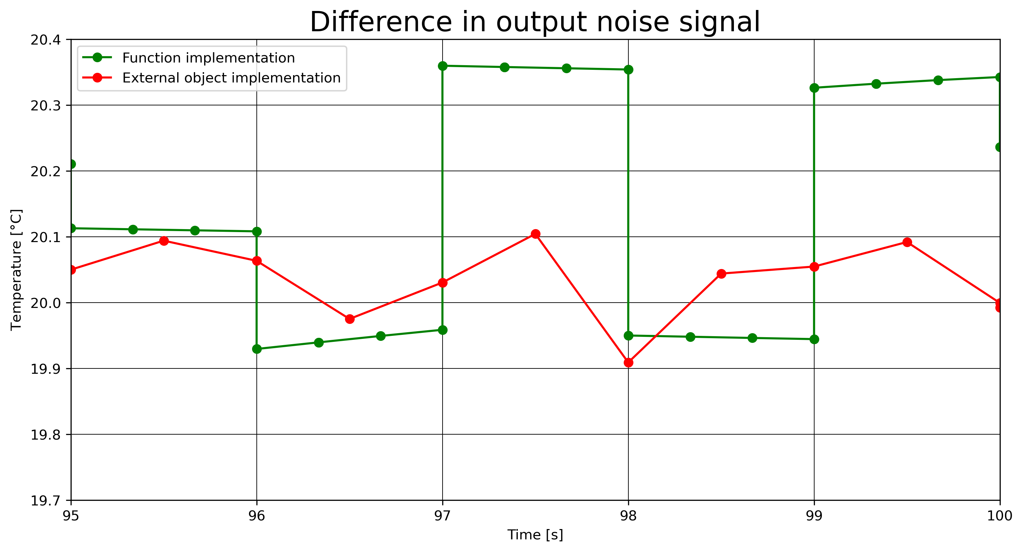
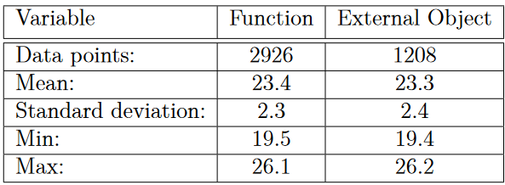
Results
Notes:
External object was implemented using the algorithm, executing code sequentially at specific time steps with a frequency of 0.5 [s].
Function Equation-based implementation utilized in the Modelica OpenModelica.

Slide 12
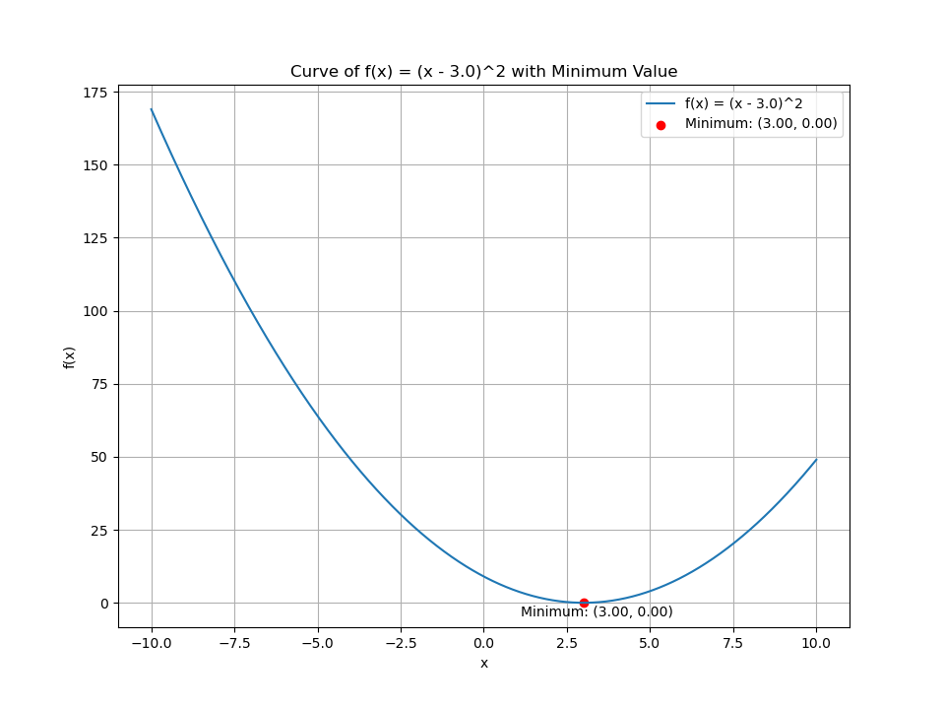
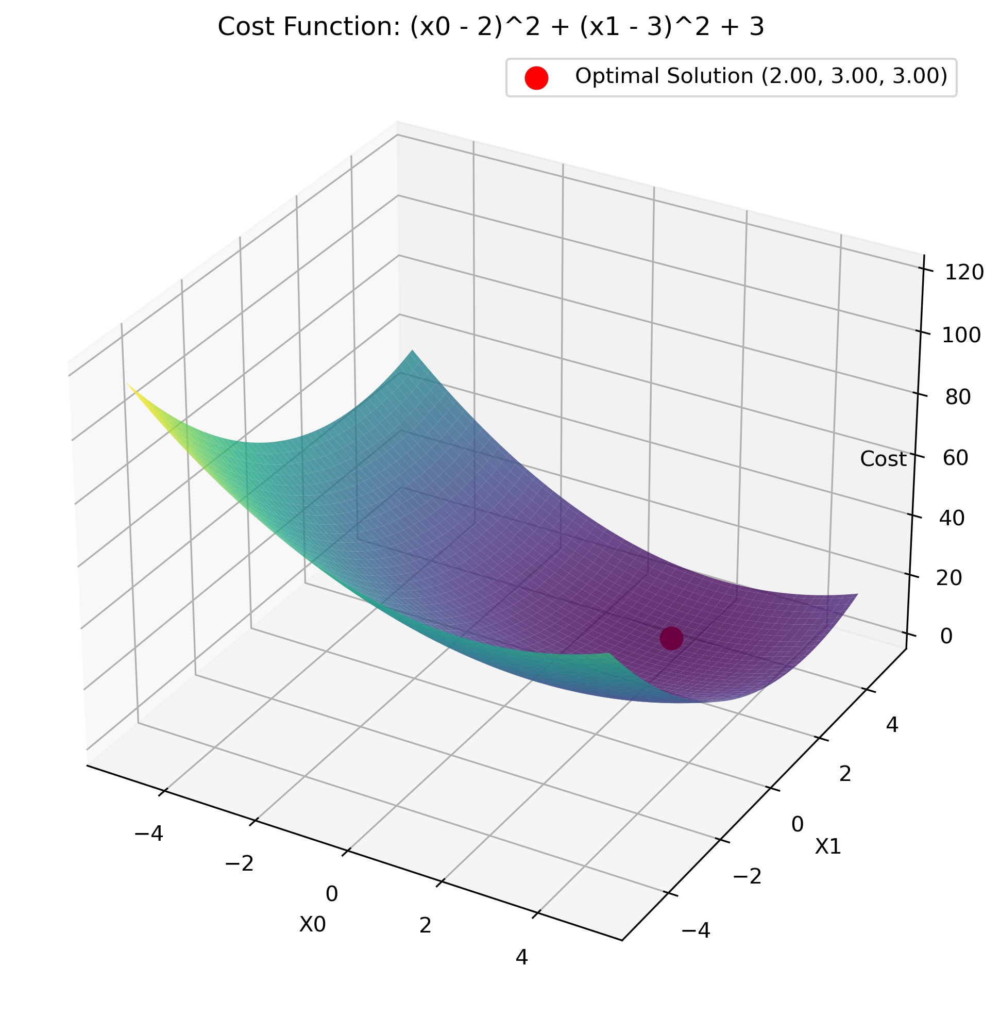
NLopt
Basic example for calling external C functions in NLopt from OpenModelica and returning values to OpenModelica
Examples of solving a univariate optimization problem in OpenModelica by calling a NLopt function in C
Examples of solving a multivariate optimization problem in OpenModelica by calling a NLopt function in C
NLopt
Version

Slide 13
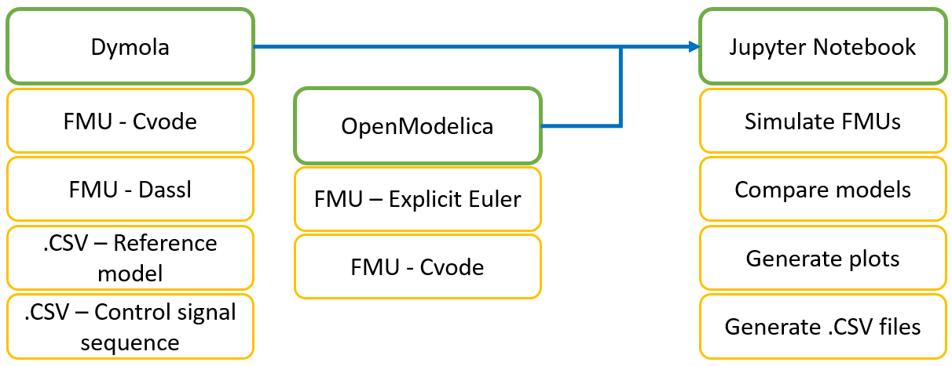
FMU of Air Heater in Python

Slide 14
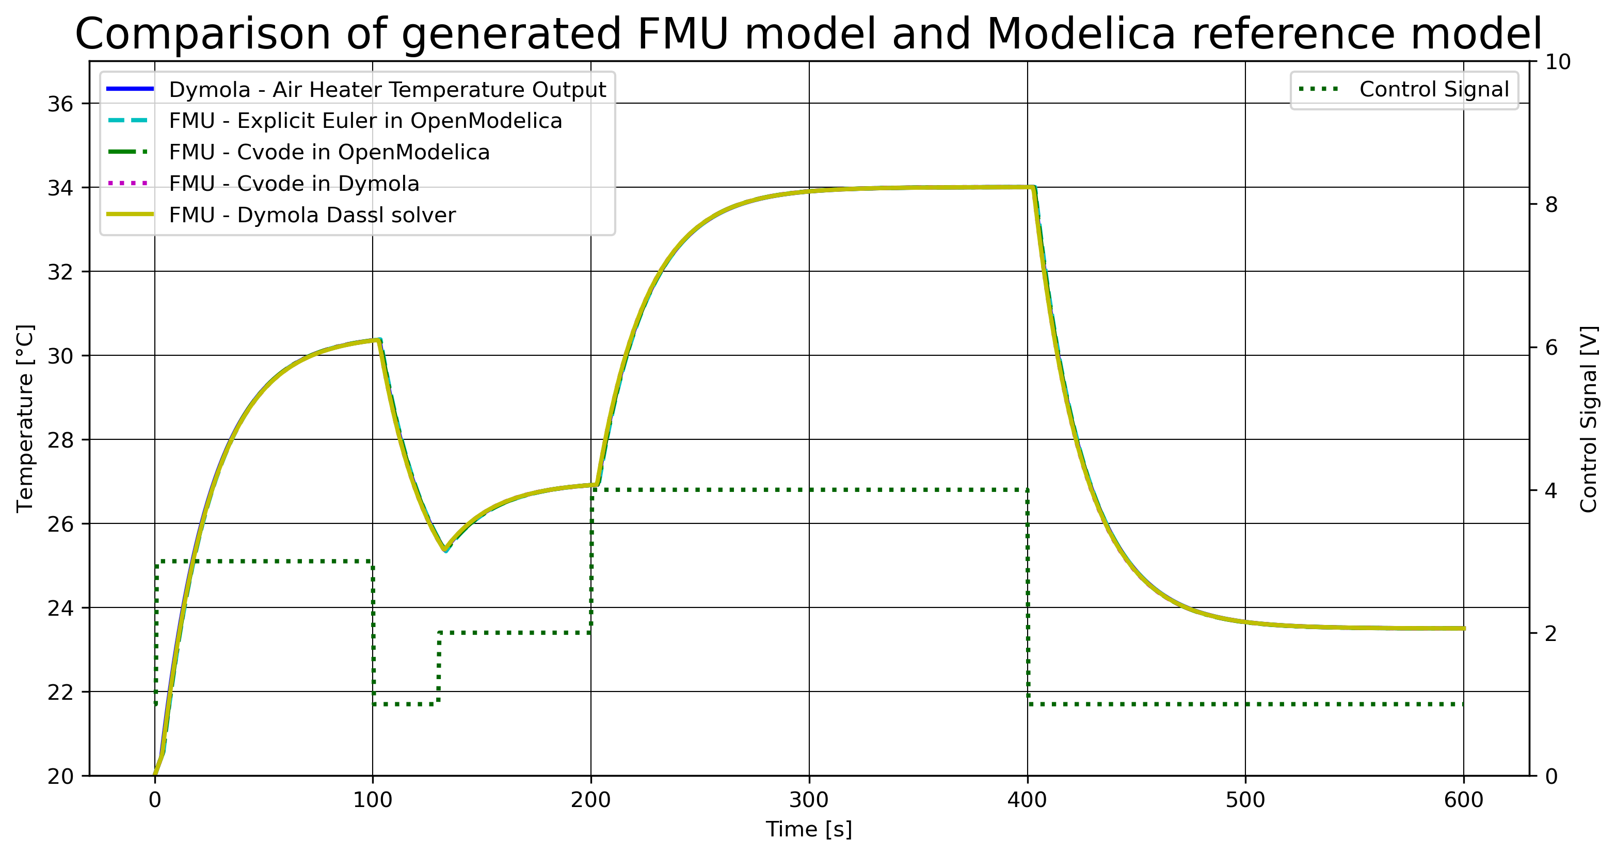
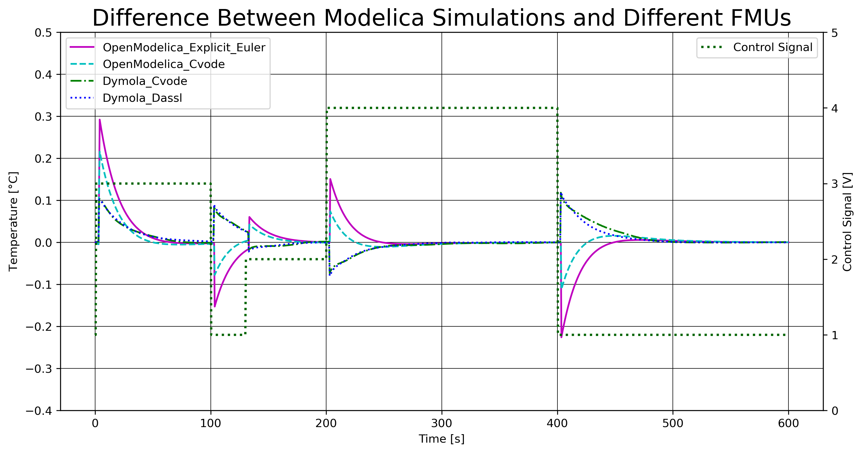
FMU of Air Heater in Python

Slide 15
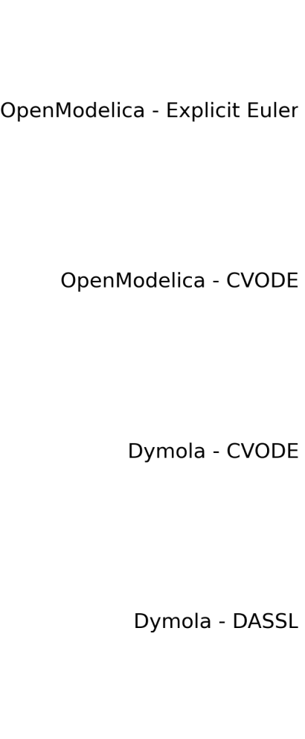
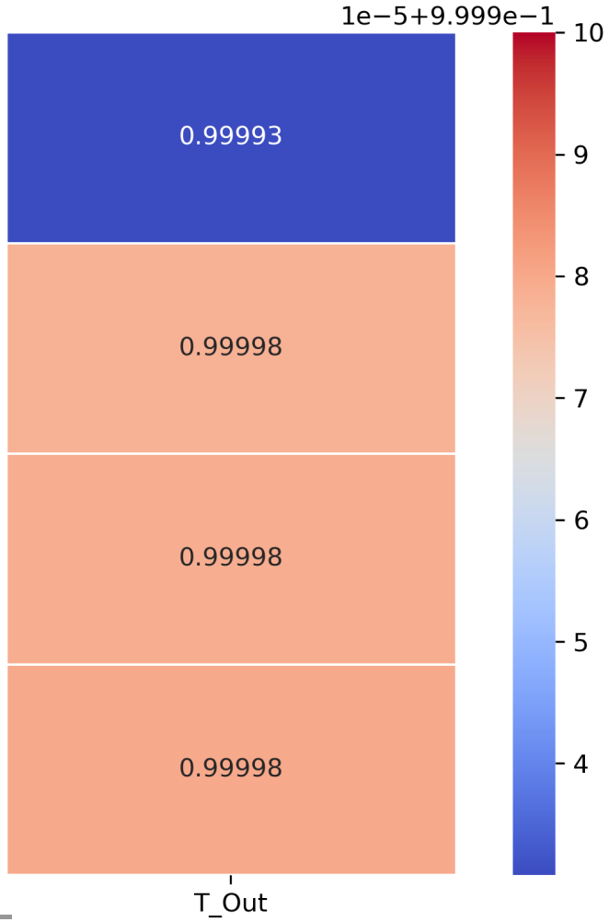

Slide 16
FMU of Air Heater with PI-controller in Python

Slide 17
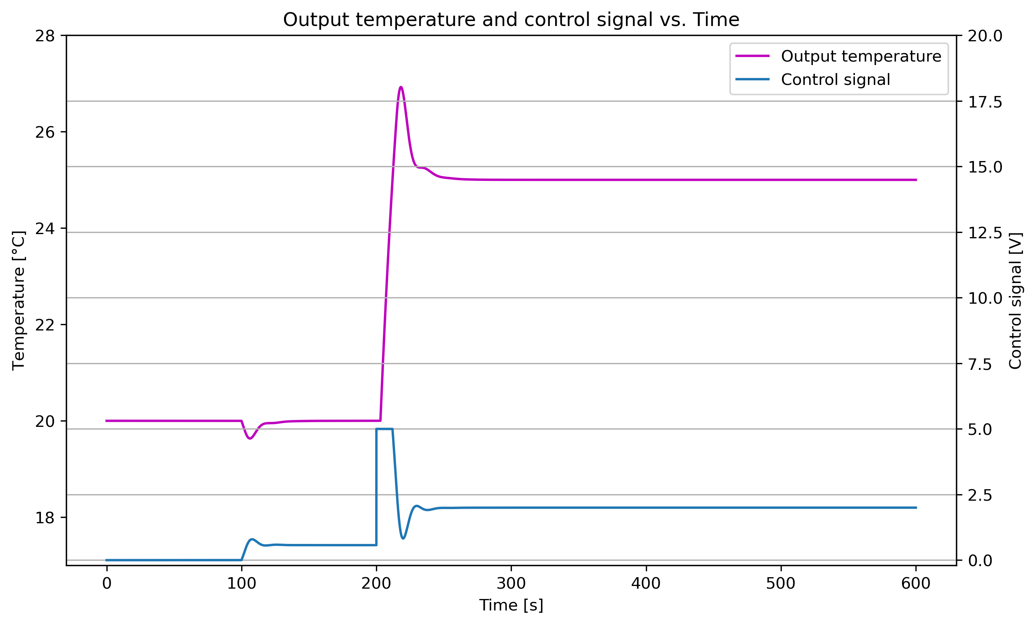
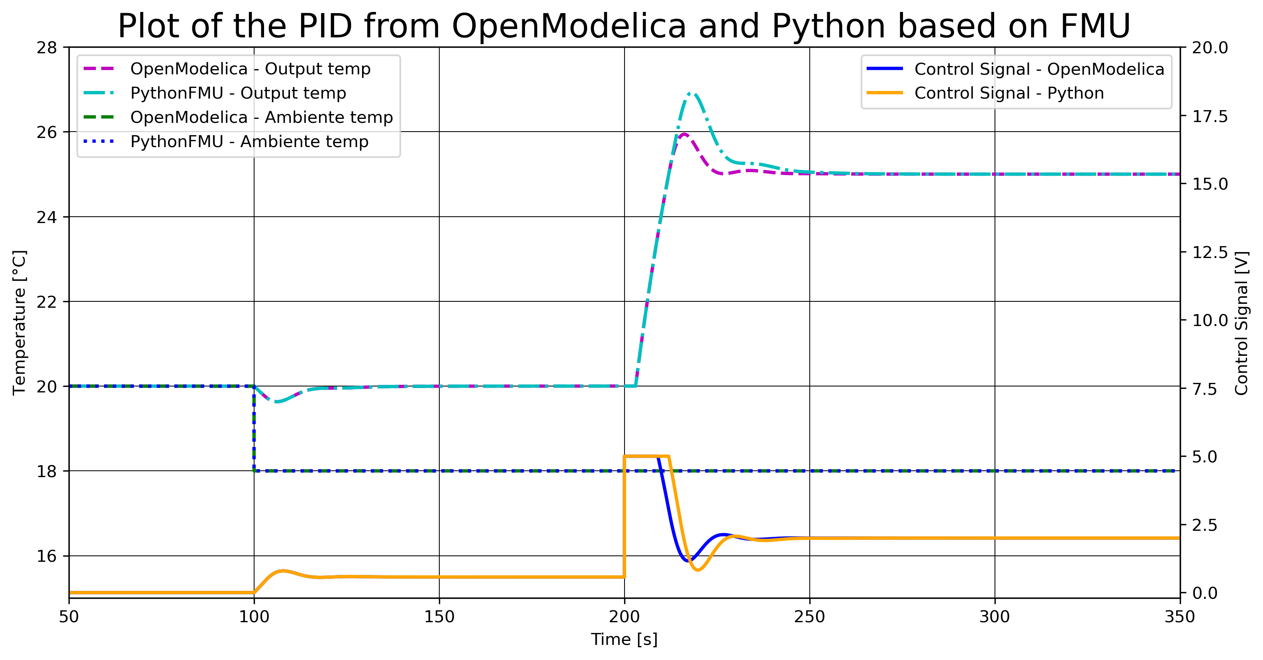
FMU of Air Heater with PI-controller in Python

Slide 18
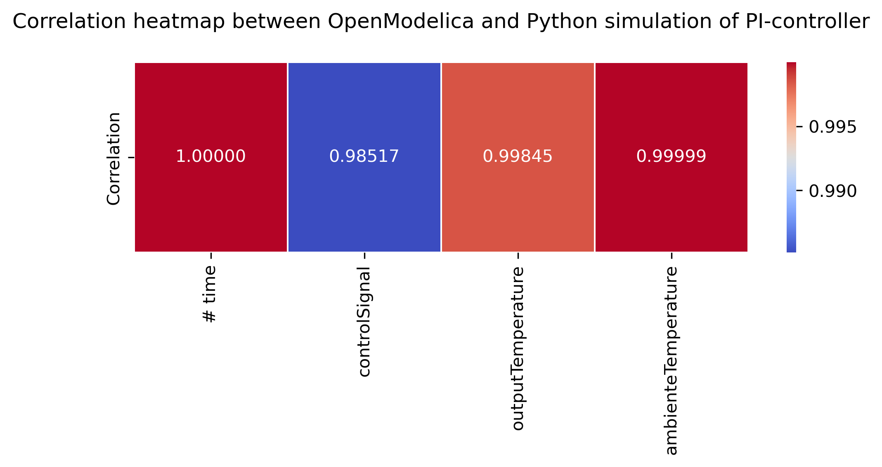
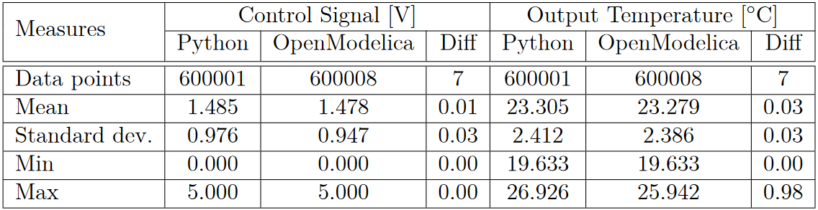
FMU of Air Heater with PI-controller in Python

Slide 19
FMU of Air Heater with MPC in Python

Slide 20
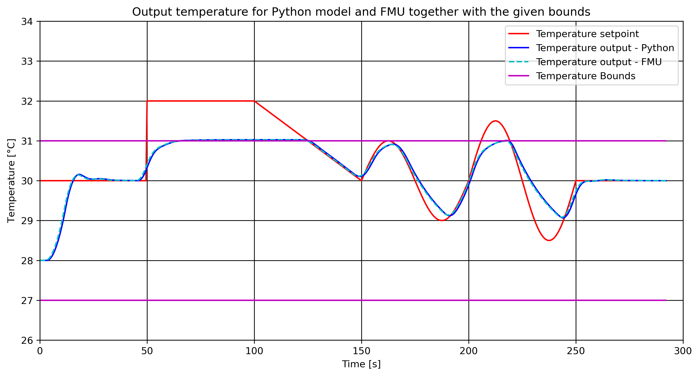
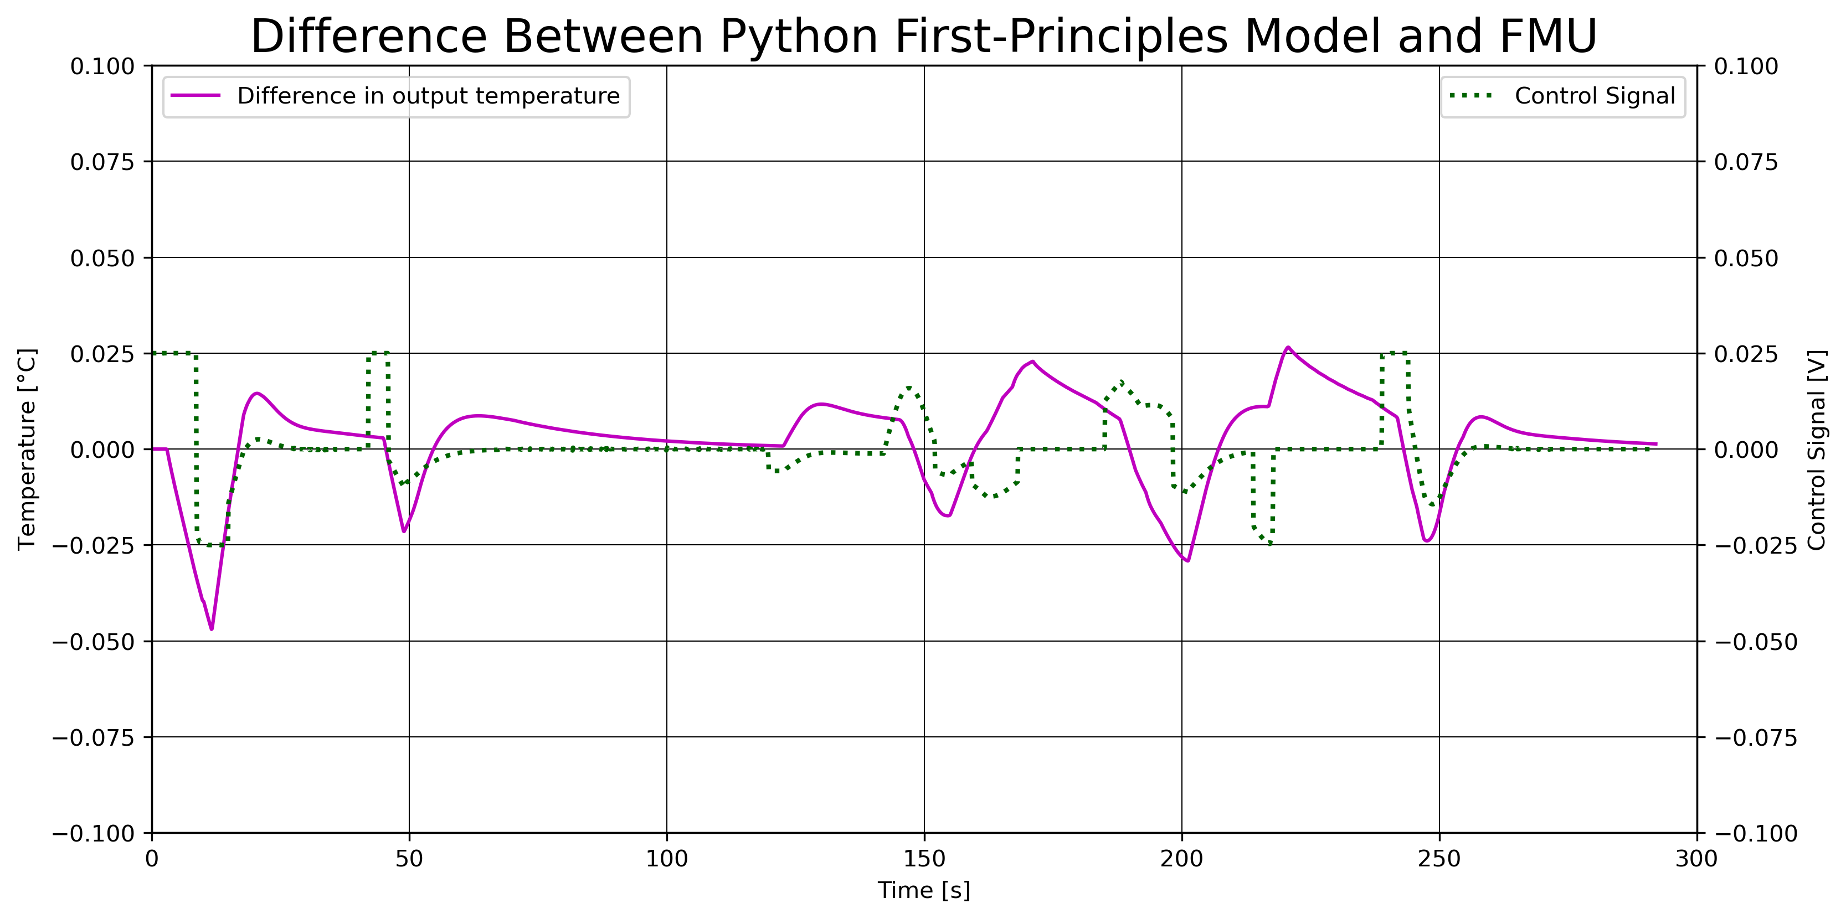
FMU of Air Heater with MPC in Python

Slide 21
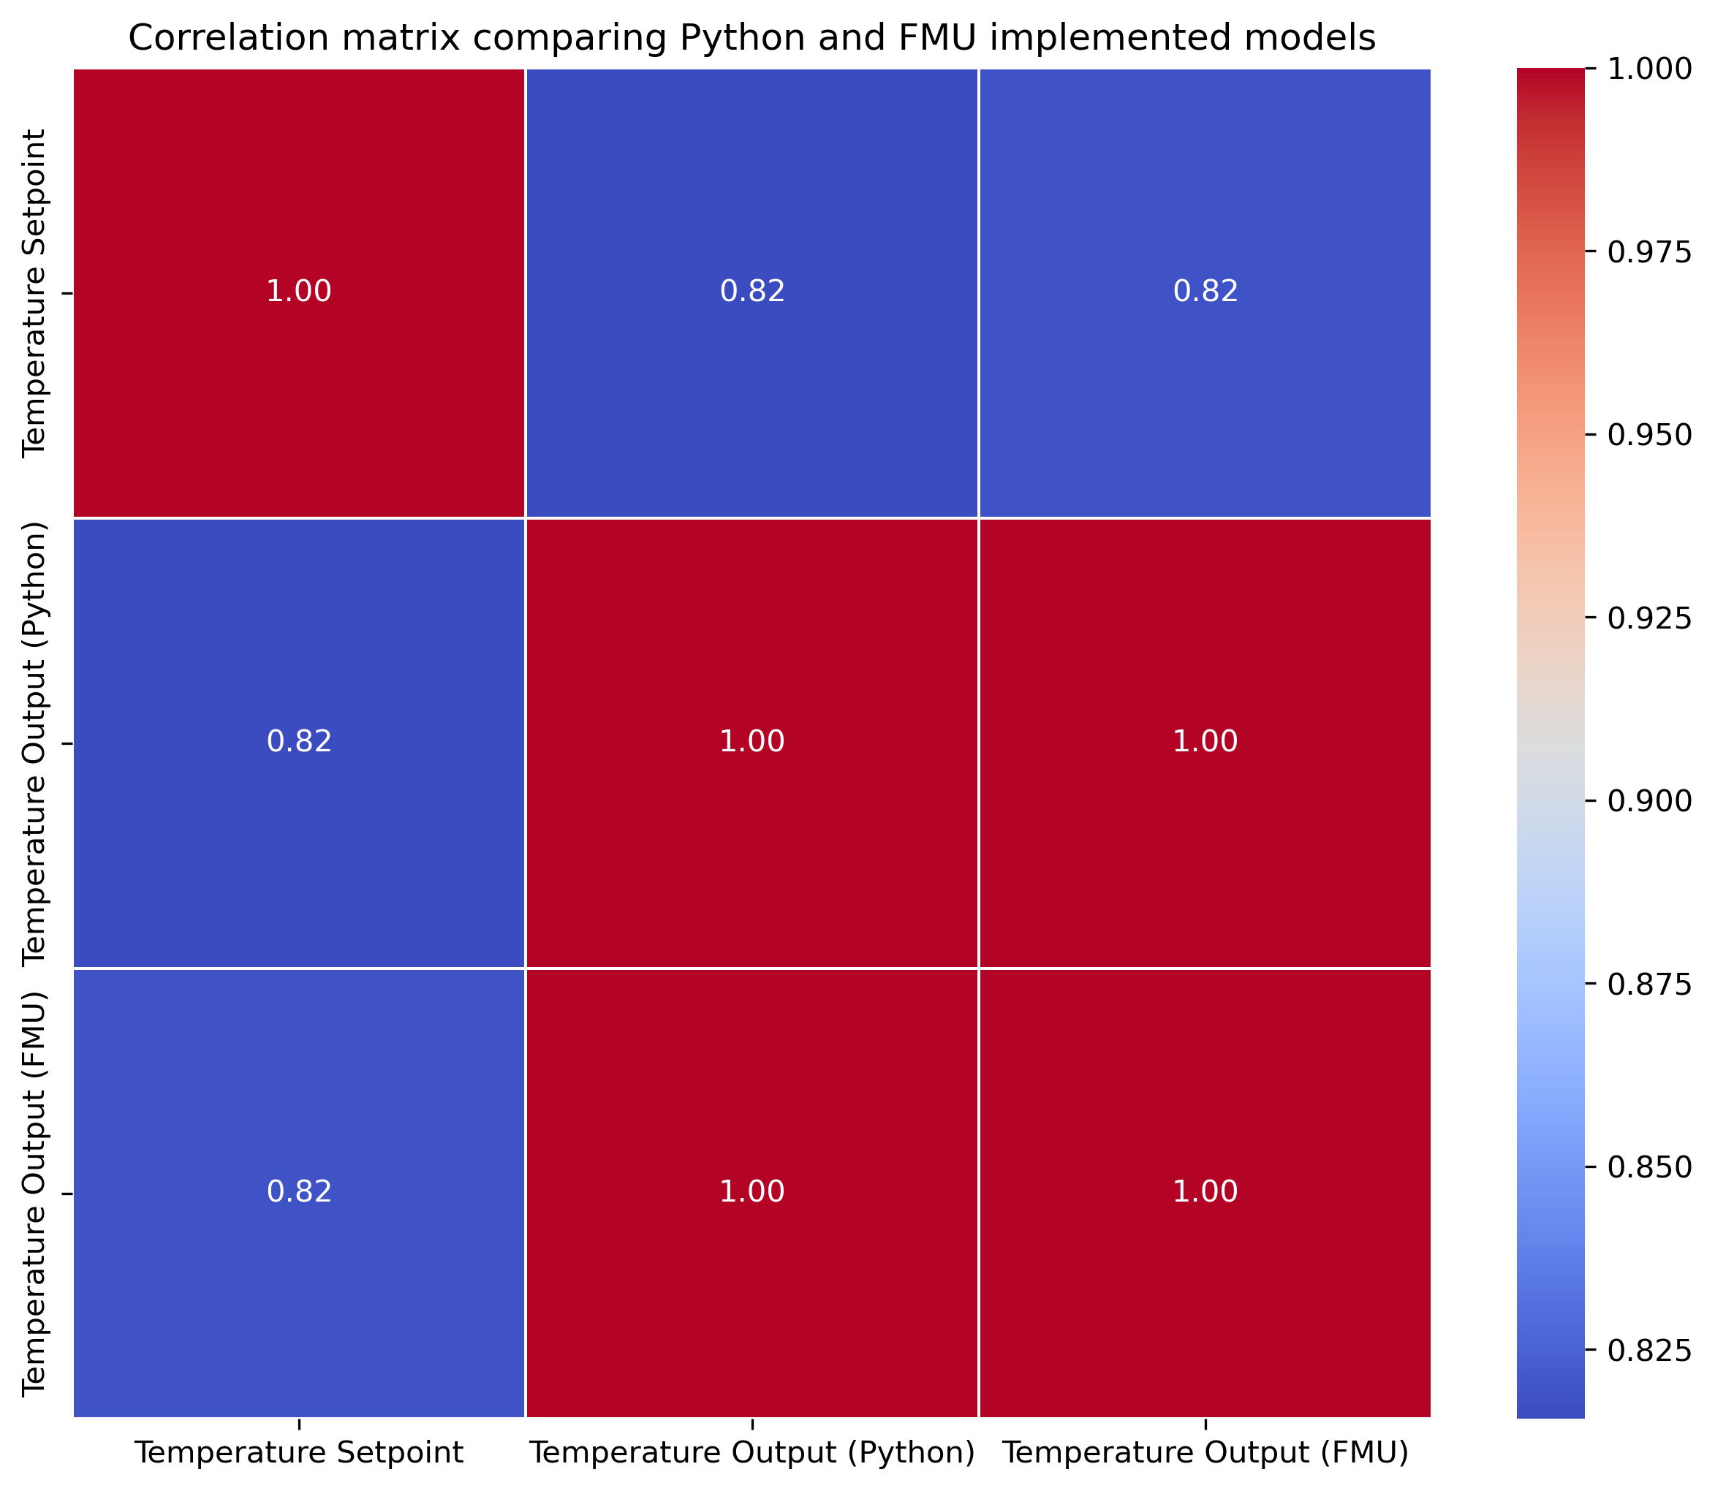
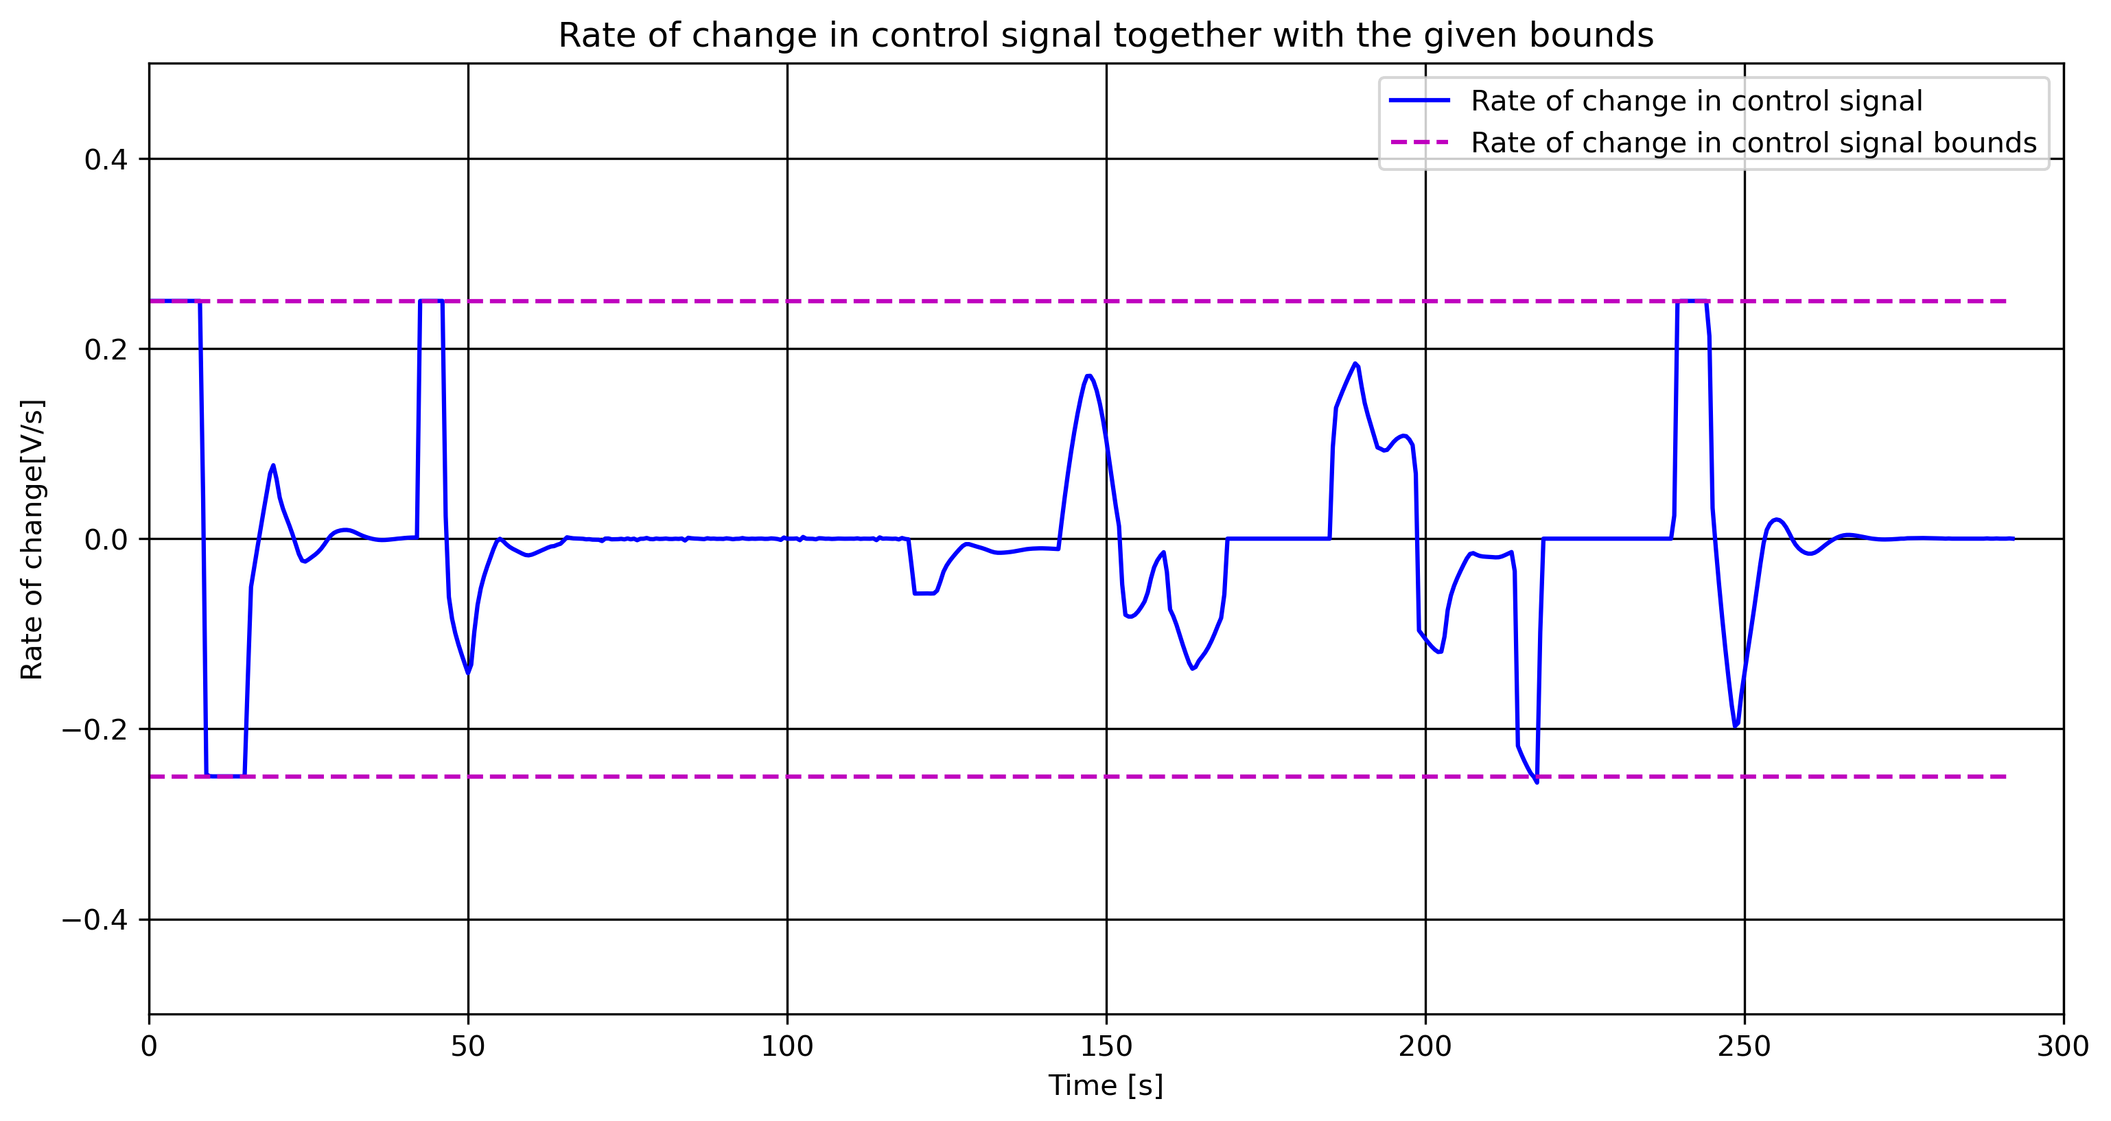
FMU of Air Heater with MPC in Python

Slide 22
Conclusion

Slide 23
Future Work

Slide 25
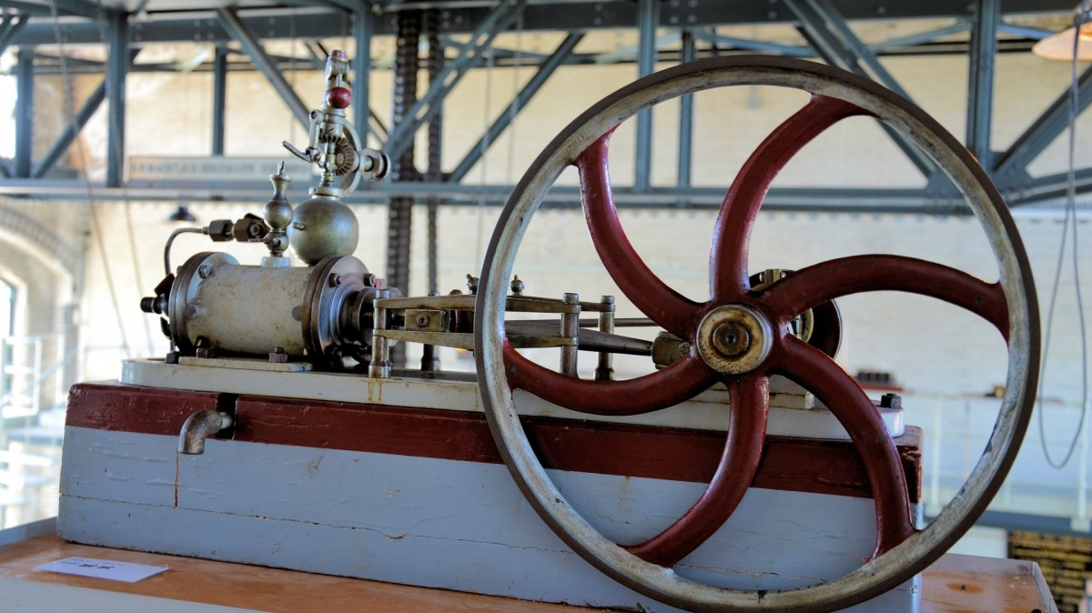

Slide 26
DRAFTS

Slide 27
Existing Options
JModelica
Discontinued in 2019
Three packages moved to GitHub:
Assimulo
Python simulation packages
PyFMI
Load and simulate FMUs
FMI Library
C package to load and simulate FMUs

Slide 28
Existing Options
FMPy - Dassault Systèmes
Free Python library
Graphical user interface
Validate FMUs
Export to Jupyter Notebook, Modelica and Cmake
Read model data
Web App to share FMUs with anyone in a browser

Slide 29
Existing Options
NLopt
Open-source library
C, C++, MATLAB, Fortran, Python among others
Collection of several algorithms from different contributors
Set up the Optimizer Object
Set up Objective Function
Set Bounds
Optimize the Problem!
Define optimizer algorithm and number of optimization variables
Combine the optimizer object and the function to be optimized
Set upper, lower, equality and inequality bounds based on algorithm capability
Use the optimizer together with the defined minimum cost and the optimization variable

Slide 30
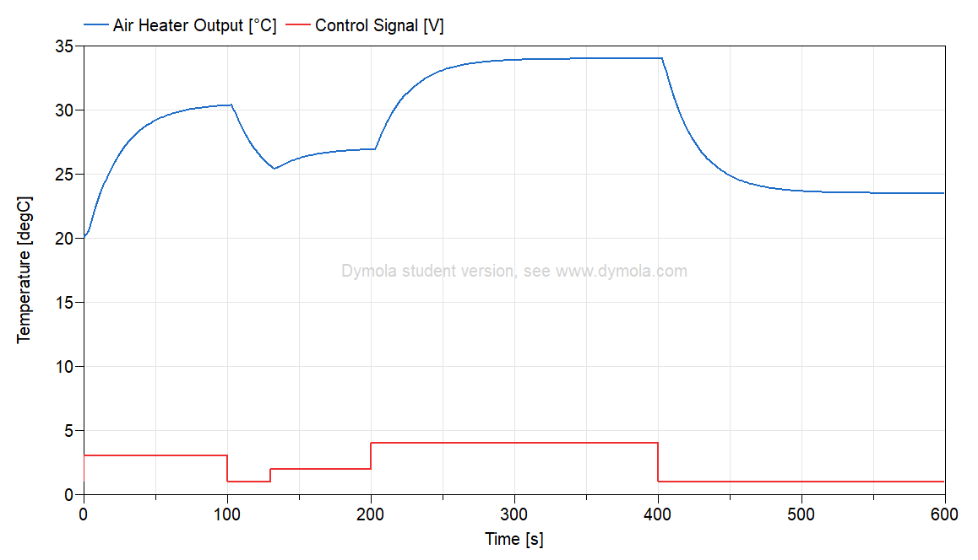
Air Heater Model
First-principles model in Modelica
$$T_{CONST}∙ der\left(T_{Out}\right)= \left(T_{amb}− T_{Out}\right)+ Kh∙ delay(u, 3)$$
Notes:
Air heater model - Time constant with time delay process dynamics
Implemented as a model in Modelica

Slide 31
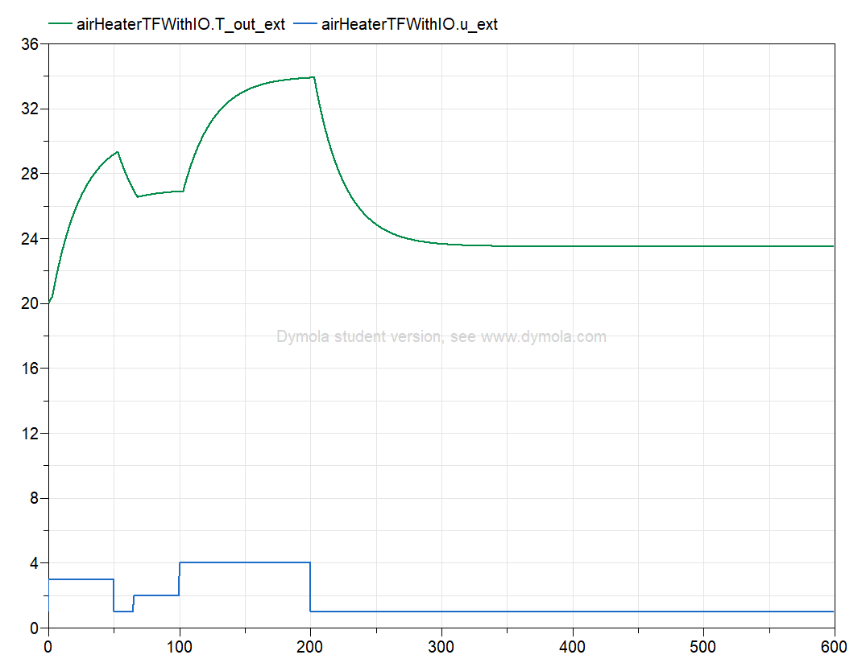
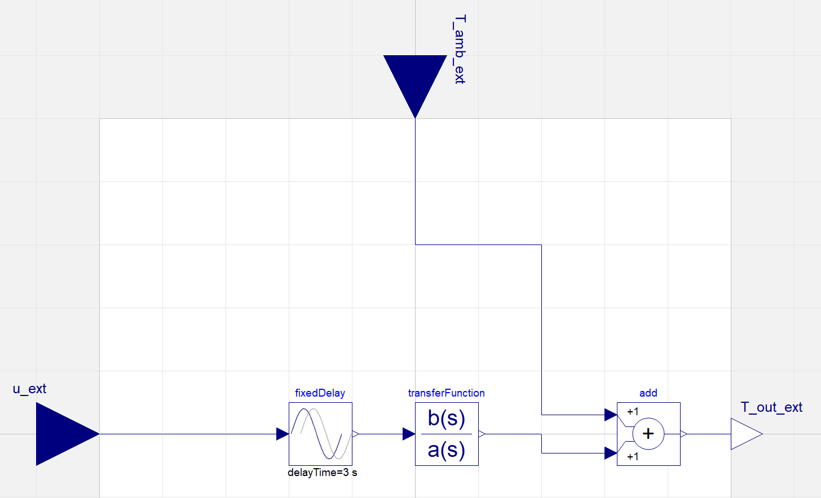
Air Heater Model
Transfer function

Slide 32
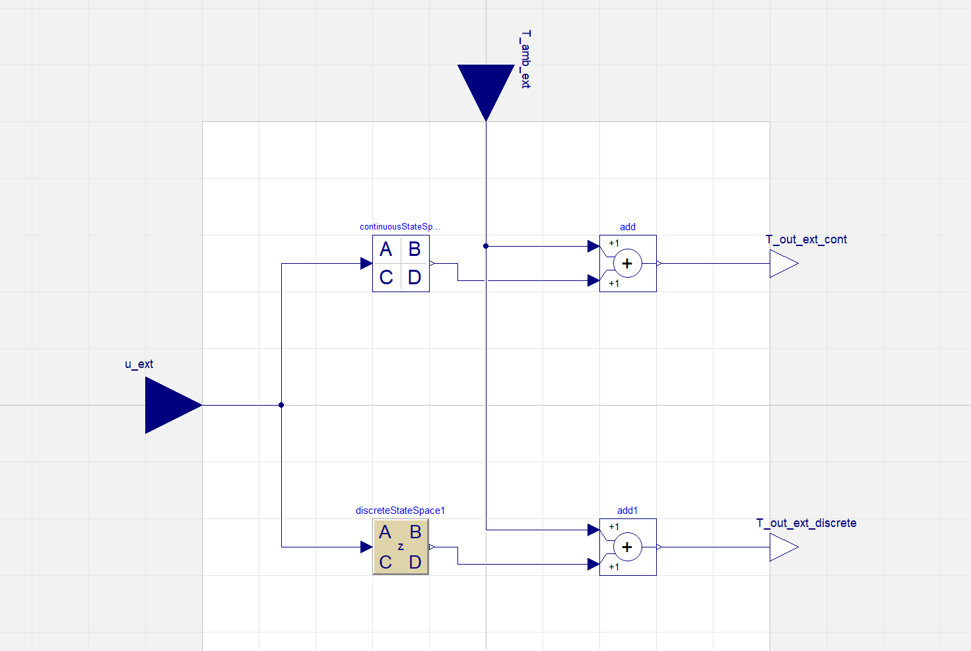
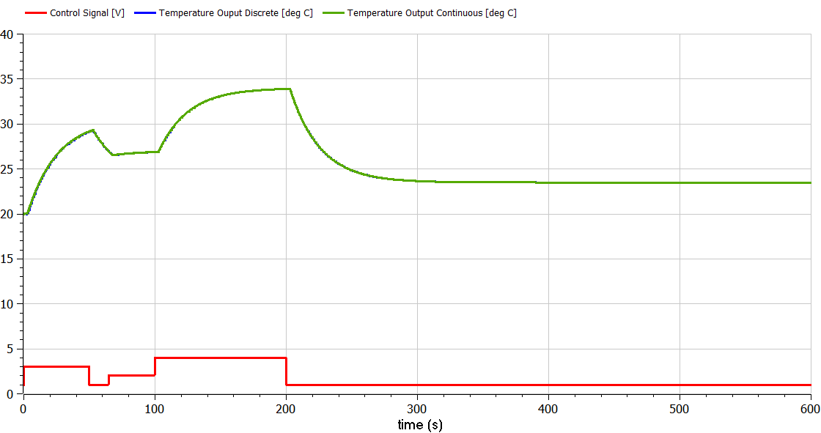
Air Heater Model
State space models

Slide 33
Air Heater Model
Model evaluation

